Slide 1
Module 3 Choosing A Competitive Strategy

Slide 2
Lesson 1 Types of Competitive Strategy

Slide 3
This Lesson
Module 1: What is Competitive Strategy
Lesson 1: What is Competitive Strategy
Module 2: Competitive Advantage
Lesson 1: What is Competitive Advantage?
Module 3: Choosing a Competitive Strategy
Lesson 1: Types of Competitive Strategy
Lesson 2: Macro-Environmental Analysis
Lesson 3: Industry Analysis
Lesson 2: Sustainable Competitive Advantage
Lesson 3: Value Chain Analysis
Lesson 2: Link to Competitive Advantage
Lesson 3: How to Choose Competitive Strategy

Slide 4
Learning Objectives
Students will be able to understand and describe the different types of competitive strategy

Slide 5
Recap-What is Competitive Strategy?
An integrated set of decisions and actions that aims to generate a sustainable competitive advantage and outperform competitors in the long run
Two Key Decisions
Where to compete
How to compete.

Slide 6
Competitive Strategies
Broad Market
Narrow Market (Niche)
 | Cost/Price | Uniqueness
WHERE TO COMPETE?
HOW TO COMPETE?

Slide 7
Competitive Strategies
Broad Market | BROAD COST LEADERSHIP | BROAD DIFFERENTIATION
Narrow Market (Niche) | FOCUSED COST LEADERSHIP | FOCUSED DIFFERENTIATION
 | Cost/Price | Uniqueness
WHERE TO COMPETE?
HOW TO COMPETE?

Slide 8
Competitive Strategies
Broad Market | BROAD COST LEADERSHIP | BROAD DIFFERENTIATION
Narrow Market (Niche) | FOCUSED COST LEADERSHIP | FOCUSED DIFFERENTIATION
 | Cost/Price | Uniqueness
BEST-COST STRATEGY
WHERE TO COMPETE?
HOW TO COMPETE?

Slide 9
Cost Leadership Strategy
Highlights
Lowest costs in industry
Acceptable levels of quality​
Compete on lowest prices or enjoy higher profit margins​
Examples of Broad Cost Leadership: Walmart, Model T​
Examples of Focused Cost Leadership: Dollar General, Dacia
Achieving cost leadership
Operational efficiency ​
Cost control and management ​
Economies of scale

Slide 10
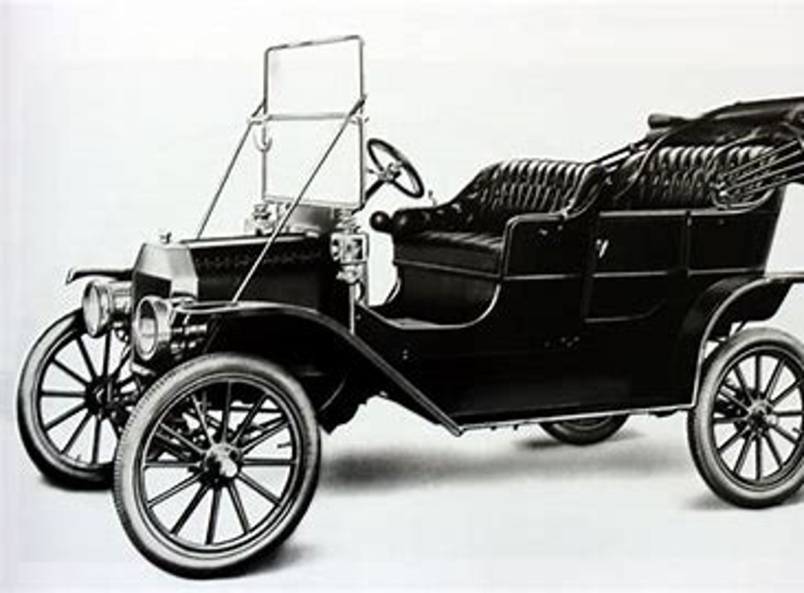
Ford Model T: Broad Cost Leadership

Slide 11
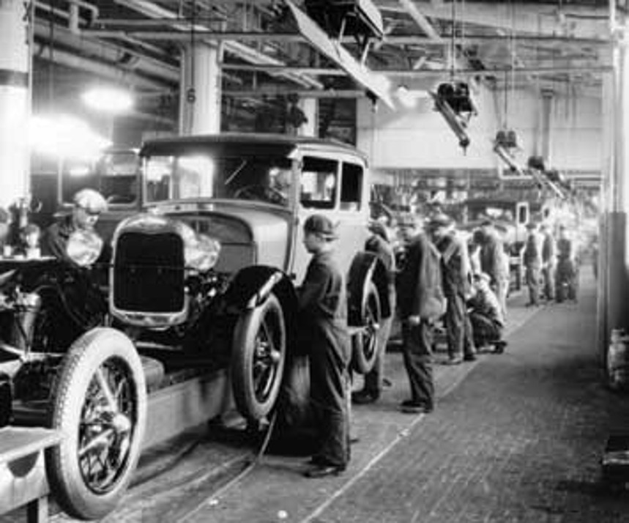
Model T’s Strategy
Launched in 1908
“Car for the masses.” Target the mid-market
Affordable price ($850 in 1908, declining to just $290 by 1924).
“Mass Production via Assembly Lines”
“Any car you want, as long as it’s black”
Better quality than existing cars
Economies of scale

Slide 12
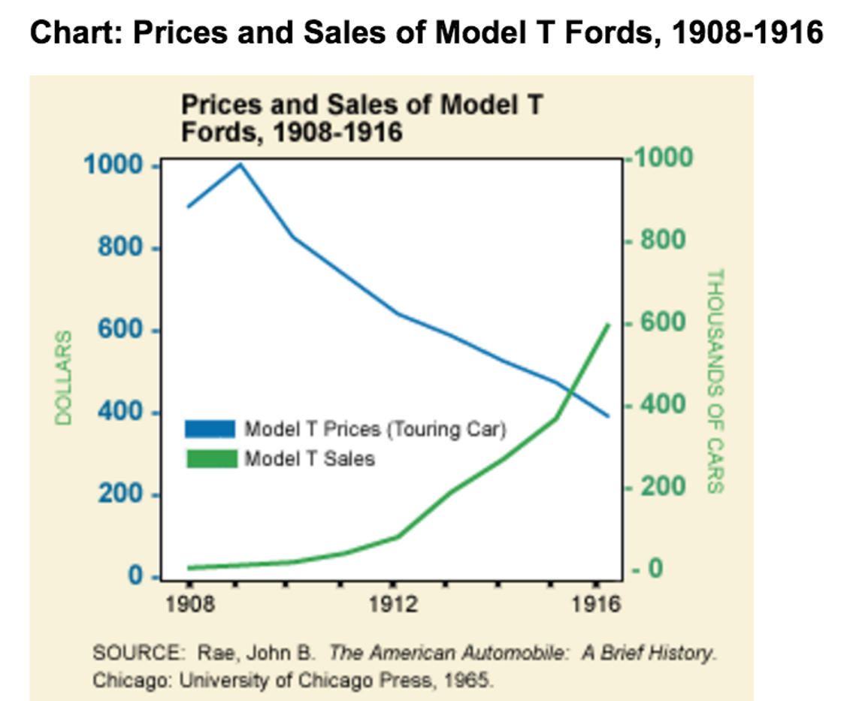
By 1916, Model T Prices fell below $400 and sales increased to 600k per year
Source: “Lessons from Strategic Breakthroughs,” Case Teaching Note, INSEAD Blue Ocean Institute

Slide 13
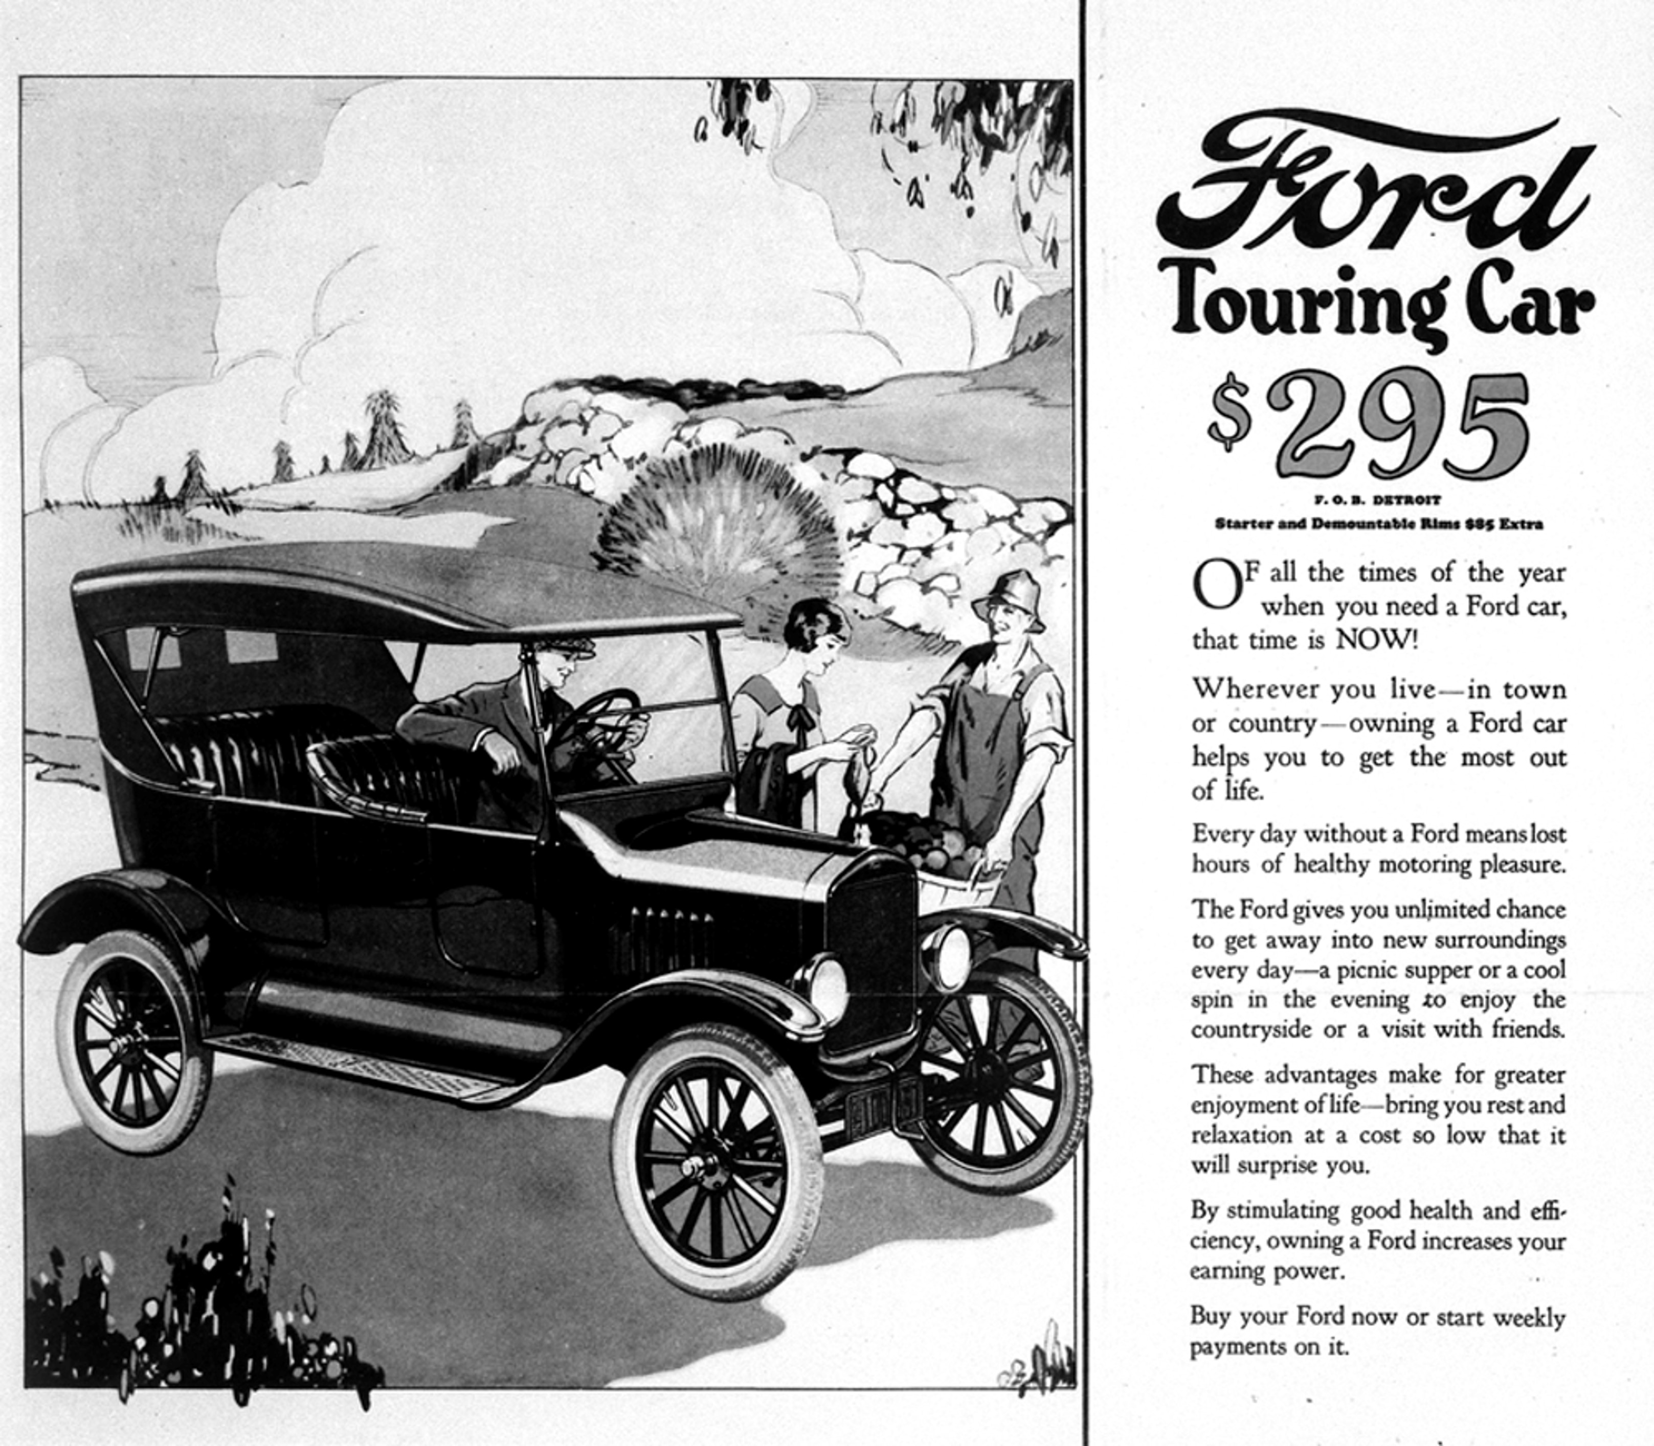
By 1924, Ford sold 10 million cars and 9 out of 10 cars in the world
Source: “Lessons from Strategic Breakthroughs,” Case Teaching Note, INSEAD Blue Ocean Institute

Slide 14
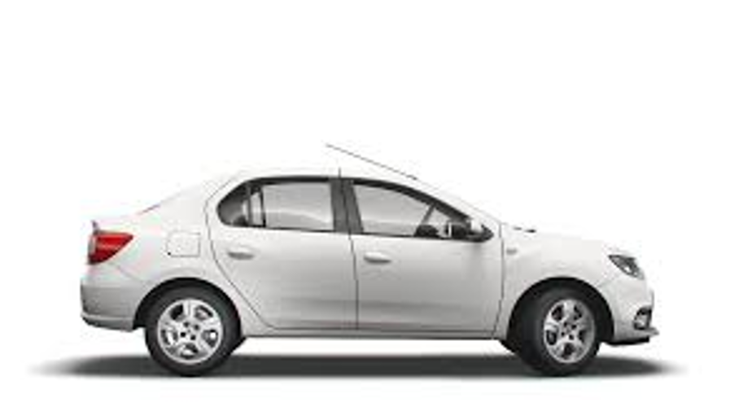
Dacia: Focused Cost Leadership
Romanian automobile company
Owned by Renault
Targets budget-conscious car buyers
“Affordable and reliable cars”
The Dacia brand is marketed in most of the Western and Eastern European countries, as well as in some Northern African countries.

Slide 15
What is Differentiation Strategy?
Highlights
Exceptionally valuable product features, service or brands
Premium prices
Examples of broad differentiation: Nike, Apple, Singapore Airlines, Coca-Cola
Examples of focus differentiation: Rolls Royce, Ritz Carlton, Patagonia, Tesla
Some Ways to Achieve Differentiation
Product Differentiation (product features, performance, quality, design and innovation)
Service Differentiation (exceptional service)
Brand Differentiation (brand image, reputation, customer loyalty)

Slide 16
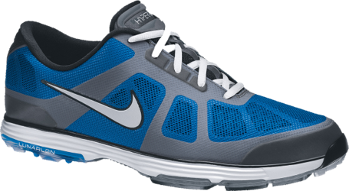
Nike Shoes: Broad Differentiation
Premium brand, emphasizing its reputation for quality, performance, and innovation.
Offers products at various price points to cater to a broad range of consumers across several sports.
Endorsements by top athletes
Invests heavily in R&D, branding and marketing
Commands premium prices

Slide 17

Patagonia: Focused Differentiation
Outdoor Apparel
Target market of outdoor enthusiasts and environmentally conscious consumers.
High-Quality and Durable Products
Activism on Environmental and Social issues
Ethical & Responsible Supply Chain
Strong emphasis on Environmental Sustainability

Slide 18
Best-Cost Strategy
Differentiation + Cost Leadership
Differentiated products and services at competitive prices
Difficult to achieve, but difficult to copy
Powerful strategy resulting in sustainable competitive advantage

Slide 19

Amazon's Best-Cost Strategy
Cost Leadership
Operational excellence
Economies of scale
Cost control management
Differentiation
Broad product selection
One-click buying
Fast order fulfillment and delivery
Excellent user experience and customer service

Slide 20
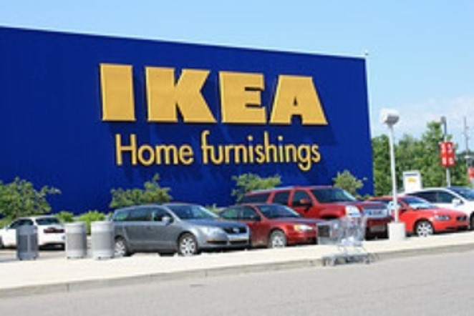
IKEA’s Best-Cost Strategy
Cost Leadership
Global scale, cost-conscious culture, self-service, DIY, flat pack concept
Affordable prices
Differentiation
Unique, stylish furniture
Distinctive shopping experience
Strong brand reputation
Broad product range

Slide 21
Next Lesson
Module 1: What is Competitive Strategy
Lesson 1: What is Competitive Strategy
Module 2: Competitive Advantage
Lesson 1: What is Competitive Advantage?
Module 3: Choosing a Competitive Strategy
Lesson 1: Types of Competitive Strategy
Lesson 2: Macro-Environmental Analysis
Lesson 3: Industry Analysis
Lesson 2: Sustainable Competitive Advantage
Lesson 3: Value Chain Analysis
Lesson 2: Link to Competitive Advantage
Lesson 3: How to Choose Competitive Strategy

